Slide 1


Bank of Baroda Hackathon - 2022
Technology Partner
Your Team Name :Team ‘RAMA’
Your team bio : Our team "RAMA" is constantly working to solve the complications that occur between the customers and the call center agency using the concept of AI/ML, Azure resources etc bringing tranformation and scaling up the tech in banking sector.
Date :19/09/22

Slide 2
Problem Statement: Contact Centre is a very important touch point for customer service. Customers interact with the contact center for variety of services fulfilment, information about products and services, complaints, feedback, and interactions. For enhancing the contact center service levels, the customer interactions need to be analyzed and need to be mapped with customer satisfaction. Bank want to automate the process with use of AI based techniques to measure and monitor various KPIs such as call data quality, customer sentiment, Call Hygiene, customer satisfaction etc.
Why did you decide to solve this Problem statement?
These days the interaction of the customers with the call center is not satisfactory at all.Users do belong to different regions of the country and have varying linguistics.
Call centers may sometimes find it difficult to understand them and may fail to address their issues.To properly analyse the users requirement as per their satisfcation and working to achieve it, is our primary goal.
We can design a solution to achieve this objective in the best possible way by making use of the Azure resources, tools and the concept of Artificial Intelligence and Machine Learning.
If customer (user) can be analysed using the modern ai/ml technique on configurations such as data quality, customer sentiment, call hygiene ,then we can adjust those parameters to the convenience of the call center who addresses the need of the users according to their satisfaction.

Slide 3
User Segment & Pain Points
Which user /advertiser segment would be early adopter of your product & why?
Banking and Securities
Communications, Media and Entertainment
Healthcare Providers
Education
Manufacturing and Natural Resources
Government
Insurance
Retail and Wholesale trade
Transportation
Energy and Utilities

Slide 4
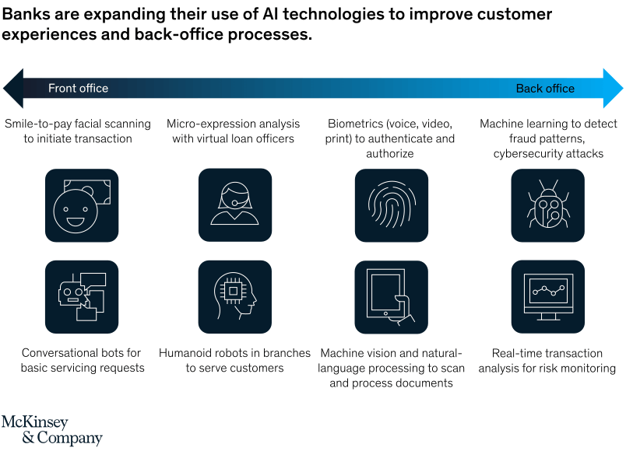
Pre-Requisite
What are the alternatives for the problem you are solving?

Slide 5

Azure tools or resources
1) Azure Storage Account (Blob Storage) 2) Azure Durable Functions(with Fan Out/Fan in pattern used) 3) Azure Cognitive Services Text Analytics(to apply sentiment analysis) 4) Azure Cognitive Services Computer Vision(to apply OCR scan on PDF files) 5) Azure Video Indexer(to analyze audio and video content) 6) Azure Cosmos DB(to store analysis results as JSON documents) 7) Power BI (to visualize collected data in a form of report ) 8) Azure Application Insights to monitor solution and discover issues

Slide 6
Methodology And Any Supporting Functional Documents
METHODOLOGY
Audio/video or PDF file is uploaded to the Azure Blob Storage
Azure Function is triggered once the new file is uploaded
File extension is verified by FileAnalysisOrchestrator function and basing on the file content type, either TextFileAnalyzer function is triggered (for PDF files) or AudioVideoFileAnalyzer function is triggered (for the audio and video files). FileAnalysisOrchestrator function app is responsible for orchestration of the the process related to calling specific function and getting analysis result so it can be passed to the third function app (AnalysisResultAggregator) responsible for inserting data into the Cosmos DB container
Once data is collected, in the Power BI Desktop application we can set Cosmos DB as data source and display data using different charts
Supporting Document:
https://www.researchgate.net/publication/276437751_Impact_of_Big_Data_Analytics_on_Banking_Sector_Learning_for_Indian_Banks
https://www.researchgate.net/publication/297420730_Banking_on_big_data_A_case_study
https://link.springer.com/chapter/10.1007/978-3-030-78307-5_13

Slide 7
Key Differentiators & Adoption Plan
FEATURES OF OUR MODEL
Handling low quality calls that are not clear.
Handling calls with noisy background.
Security of data and authentication of user with the Azure resource.
Handling complex queries through Azure Bot Framework.
Post analysis of customer on the basis of their interaction
BUILD ADOPTION
We will improve contact with our customers based on the analysis of recorded audio and video or chat history.
We will try to know what is the average time of the conversation with the customer in our call center.
We will count how many customers are satisfied with the help which is given during the conversation with the call center's assistant.
We will be finding what are the most popular topics of conversations.

Slide 8
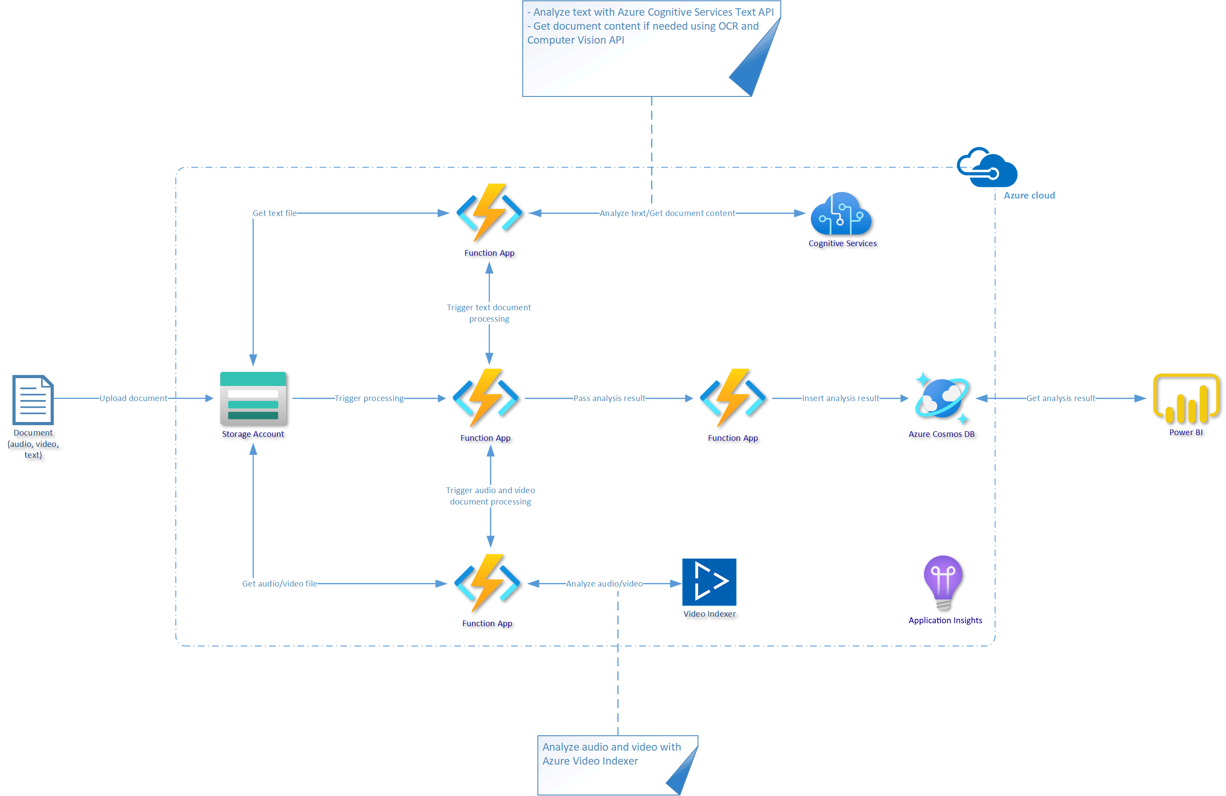
GitHub Repository Link & supporting diagrams, screenshots, if any :
https://github.com/VANSHIKAAGARWAL571/BankOf-BarodaHackathon/upload
How far it can go?

Slide 9
Thank You
Team members: Shubham Gupta (Lead)
: Vanshika Agarwal
: Vanshika Agrawal
: Sachin Gupta

